Slide 1
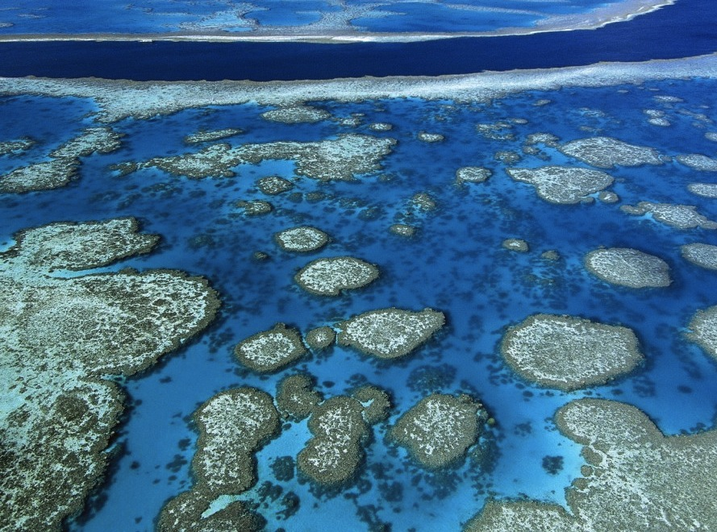
Physiologically relevant bleaching threshold methods provide updated global coral bleaching predictions
Cheryl Logan, California State University, Monterey Bay
John Dunne, NOAA-GFDL
Mark Eakin, NOAA Coral Reef Watch
Simon Donner, University of British Columbia

Slide 2
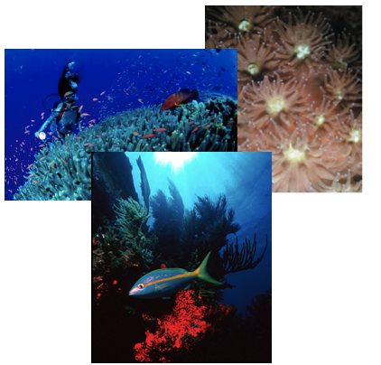
Coral Reefs: A Vital Ecosystem
Economic Benefits
Commercial fishing
Tourism
Coastline protection
Natural products
Ecological Benefits
Jim Raymont, James McVey
Structural habitat
High biodiversity
Notes:
Coral reefs are vital ecosystems, providing many economic and ecological benefits.

Slide 3
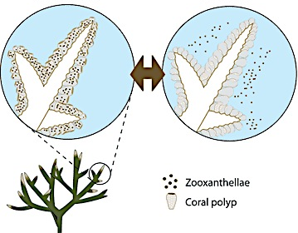
Coral Reef Bleaching
Coral Reef Bleaching
What is it?
Corals expel the symbiotic algae that provide them energy (and color)
Healthy Coral Bleached Coral
Causes/ Threats
Temperature Stress
Solar irradiance
Water flow
Acidification
Sedimentation
GBRMPA
Notes:
The primary mechanism for bleaching is temperature stress.
Regional-scale coral bleaching is strongly as- sociated with elevated temperatures, particularly during recurrent ENSO events.. Stressed, overheated corals expel most of their pigmented microalgal endosymbionts, called zooxanthellae, and become pale or white. If thermal stress is severe and prolonged, most of the corals on a reef may bleach, and many may die.

Slide 4
NOAA Coral Reef Watch Program
Continuous monitoring of satellite SSTs at global reef scales
Provide researchers and stakeholders information about when bleaching is likely
Prediction tools lead to appropriate management decisions and design of global climate policy
Notes:
QUICK!
Thus the importance of having an accurate prediction method at a global scale!!

Slide 5

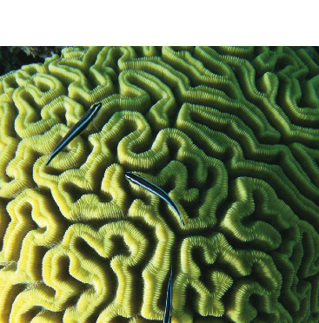
CRW Coral Bleaching Prediction Method:
Anomalies above the mean maximum monthly climatology (MMM) are summed over 12 weeks
32
31
30
29
28
anomaly
anomaly
SST (°C)
MMM climatology
1 2 3 4 5
Week
Glynn and D'Croz 1990; Liu et al. 2003
Notes:
The CRW method is based on empirical evidence showing that corals bleach at about ~1C above their average summertime maximum temperature
To determine the likelihood of bleaching, a cumulative sum of these anomalies are added up over the previous 12 weeks above the average summertime maximum temperature experienced on that reef
This MMM value is called the Climatology. It is the mean SST of the average warmest month each year ( for example all of the Augusts) during the historical period over which satellite sea surface temperatures are available: 1985-2010,

Slide 6
Degree Heating Week (DHW) =
Anomaly_{week1}+ Anomaly_{week2} + … + Anomaly_{week12}
DHW > 4 = bleaching likely
DHW > 8 = mortality likely
Glynn and D'Croz 1990; Liu et al. 2003
Glynn and D'Croz 1990; Liu et al. 2003
Glynn and D'Croz 1990; Liu et al. 2003
Glynn and D'Croz 1990; Liu et al. 2003
Notes:
This cumulative heat stress value is called a Degree heating Week or DHW
The units are in degree C-weeks
A value greater than 4 indicate that bleaching is likely
A value greater than 8 indicate that bleaching and subsequent mortality are likely

Slide 7
Applied to monthly data:
Degree Heating Month (DHM) =
Anomaly_{month1}+ Anomaly_{month2} + Anomaly_{month3}
DHM > 1 = bleaching likely
DHM > 2 = mortality likely
Donner et al. 2005
Notes:
This cumulative heat stress value is called a Degree heating Week or DHW
The units are in degree C-weeks
A value greater than 4 indicate that bleaching is likely
A value greater than 8 indicate that bleaching and subsequent mortality are likely

Slide 8
Test bleaching prediction method against Reefbase observations
1. Coral Reef Watch Current Method (Control)
2. Variability Based Method
  - McClanahan et al. 2007, Oliver & Palumbi 2011, Boylan & Kleypas 2008, Teneva et al. 2011, Donner 2011
3. Modified Climatology (MMMmax)
- Donner et al. 2009, Teneva et al. 2011, Donner 2011
4. Variability + MMMmax
- Donner 2011
Notes:
MMM leads to an underestimate of the mean maximum annual SST in regions where the timing of the seasonal peak in SST varies from year to year.

Slide 9
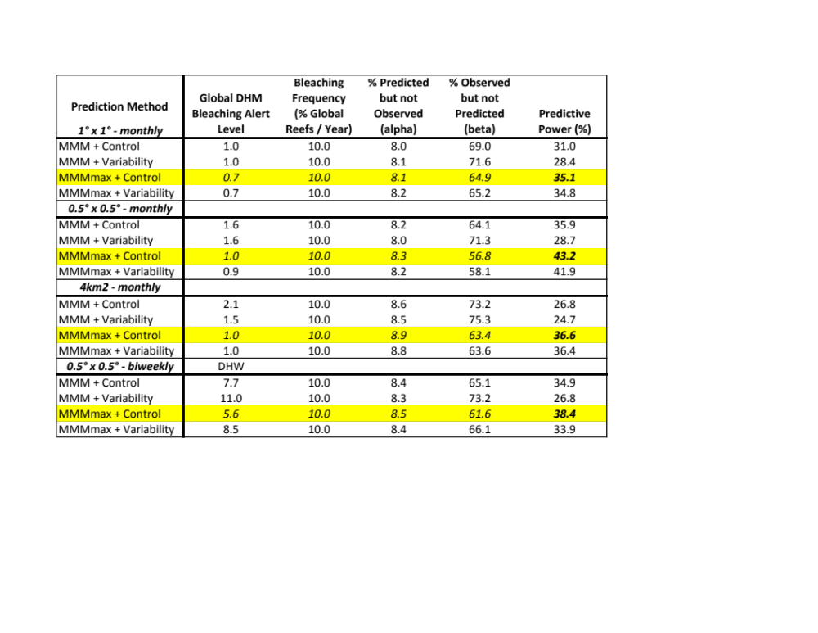
Ground-truth CRW Method with Reefbase Observations between 1985-2010
Logan et al. 2012, ICRS Proceedings
Notes:
TO assess the predictive power of the CRW method,
We used the CRW bleaching threshold to predict bleaching events between 1985-2010 using a 4 SSTs datasets at different spatial and temporal reslutions and and compared these with Reefbase bleaching observations. The CRW method is represented here as: “MMM+ Control”
In addition , we examined 2 modifications of this method recently proposed in the literature:
pdf
1) an alternate calculation for the climatology called the MMMmax, and
2) a threshold that takes into account the thermal variability experienced on a reef
The MMMmax climatology uses the warmest month each year to calculate the climatology (so instead of all the Augusts, one might use July , August, Sept, which provides a warmer climatology in the tropics where the warmest months easy year varies from year-to year)
The Variability-based threshold uses DHW/DHM threshold that varies based on the standard deviation of the temperature during climatological period, andprdicts that corals living in more varaibale environments, will be more resistant to bleaching
Finally, we examined these methods using 4 SST datasets at different spatial and temporal resolutions to see if higher resolution provides better predictive power
Why Is power so low? Bleaching also depends other extrinsic factors (light levels, nutrient availability, other stressors) and intrinsic factors ( zooxanthellae genotype, coral species)

Slide 10
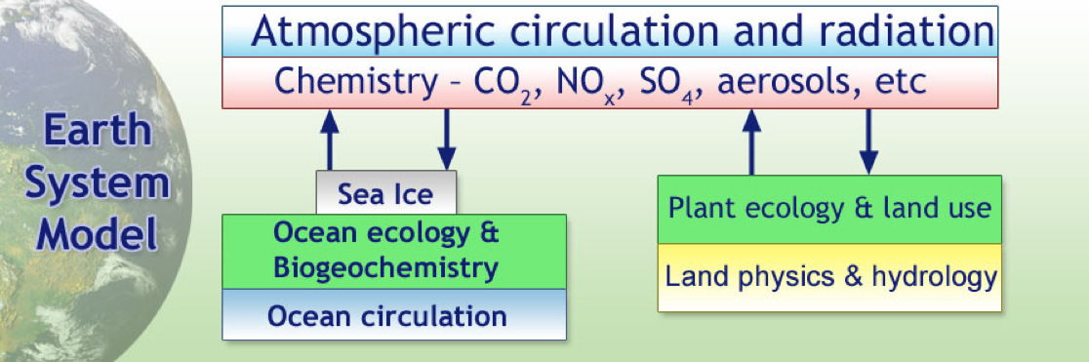
New IPCC class global climate models: Earth System Models (ESMs)
GFDL Earth System Model 2M
(1/3° grid, monthly SST output)
Notes:
Box diagram of the earth system model.
Most climate models consist of the blue and yellow boxes, with atmospheric chemistry externally specified.
In the earth system model, the green boxes indicate the components needed to close the carbon cycle in a climate model
I used to GFDL models that treat ENSO differently. 2G has a weak ENSO and 2M has a strong ENSO. This is important because ENSO events can strongly influence mass bleaching events.

Slide 11
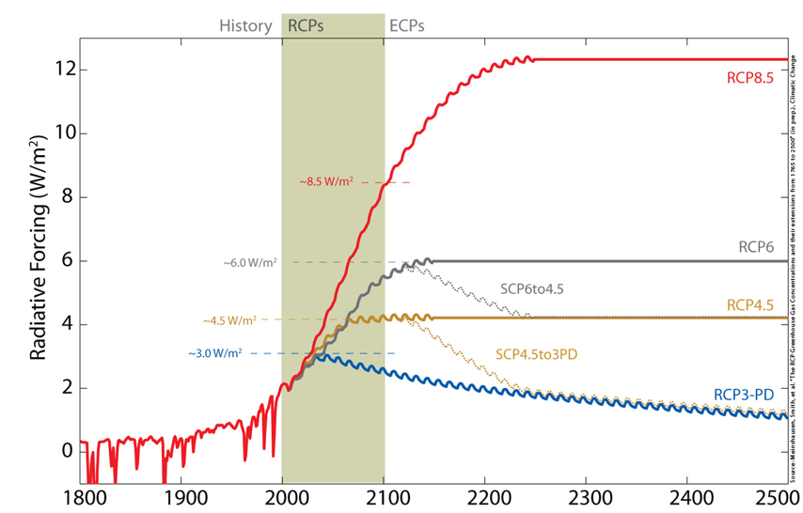
IPCC 5th Assessment future scenarios: 4 Representative Concentration Pathways (RCPs)
8.5 W/m²: Heavy emissions
6.0 W/m²: Moderate emissions
4.5 W/m²: Active mitigation
3.0 W/m²: Aggressive mitigation
Notes:
Quick!
Representative Concentration pathways or RCPs are similar to the SRES scenarios from the last IPCC report.
There are 4 scenarios, each resulting in a prescribed radiative forcing by 2100, in units of Watts per meter2
Notice that all 4 scenarios start out the same through 2020
RCPs represent radiative forcing in Watts per meter by 2100: there are 4 scenarios 3.0, 4.5, 6.0, 8.5

Slide 12
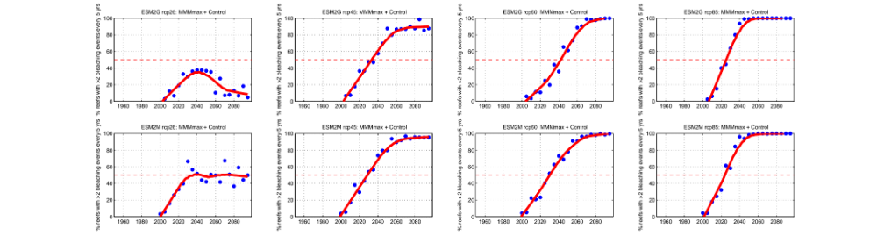
Future Bleaching under Climate Change: Mitigation Scenarios
% Global Reefs Bleaching >2x every 5yrs
3.0 W/m²
3.0 W/m²
4.5 W/m²
Active Mitigation
%
Year
Year
Climatological period
Notes:
Top = weak ENSO
Bottom = strong ENSO
On the y-axis we are looking at the % of reefs predicted to have 2 or more bleaching events within a 5 year time period, a frequency at which most reefs would not be able to recover based on empirical evidence from previous studies (Connell et al 2007, Done 1999, Sheppard 2003)
The red dotted line is simply a guide line for the eye marking the point at which 50% of global reefs would exceed this bleaching frequency
In general, the model with more frequent ENSOs predicts

Slide 13
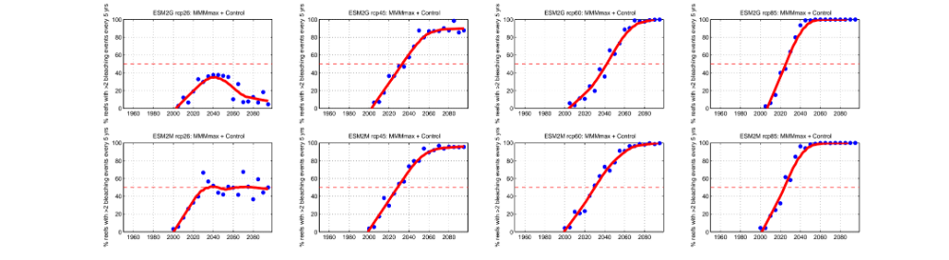
Future Bleaching under Climate Change: Emissions Scenarios
% Global Reefs Bleaching >2x every 5yrs
6.5 W/m²
8.0 W/m²
%
Year
Year
Notes:
Make mark at 50% here or write date where line crosses

Slide 14
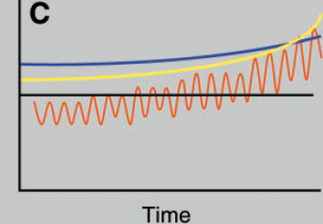
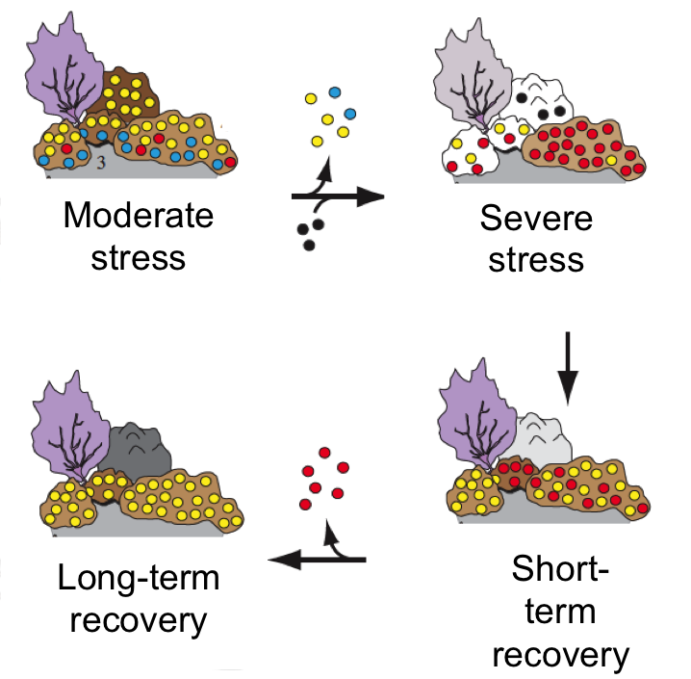
Adapt or acclimatize?
I. Thermal tolerance varies with thermal history
  Physiological acclimatization
  Directional selection
Thermal tolerance transiently increases after bleaching
  Symbiont reshuffling
  Directional selection
e.g., Hughes et al. 2003
e.g., LaJeunesse et al. 2009
Notes:
MMM leads to an underestimate of the mean maximum annual SST in regions where the timing of the seasonal peak in SST varies from year to year.

Slide 15
Could these “adaptive” mechanisms keep pace with climate change?
Notes:
To answer this question we implemented the three adaptive models using the ESM2M RCP 6.0 scenario (high ENSO, moderate emissions)
And this is what we found…

Slide 16
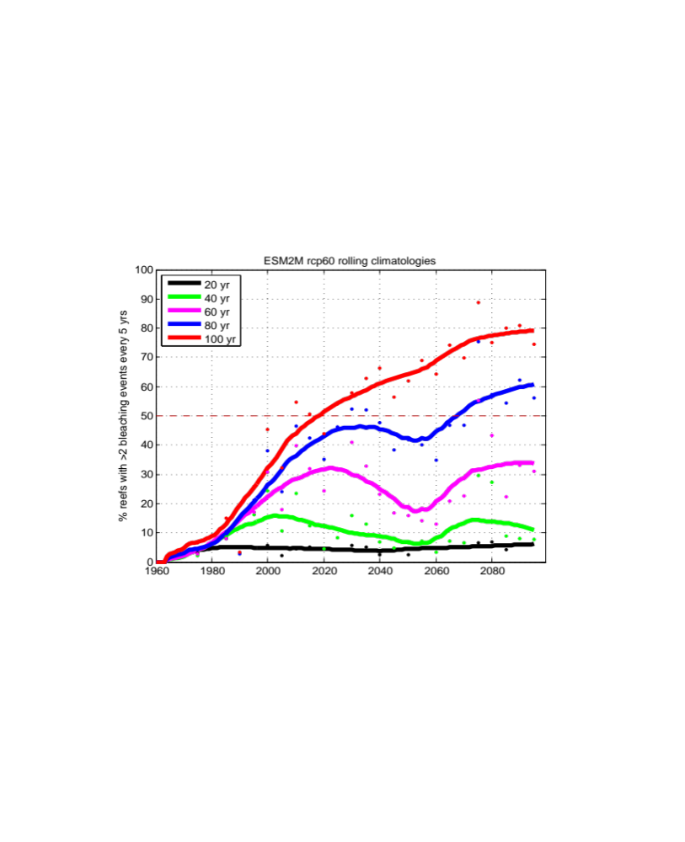
I. Thermal tolerance varies with thermal history
% Global Reefs Bleaching >2x every 5yrs
6.5 W/m²
%
Year
Notes:
We don’t how much time it takes for corals to acclimatize and whether there is some maximum upper temperature limit threshold

Slide 17
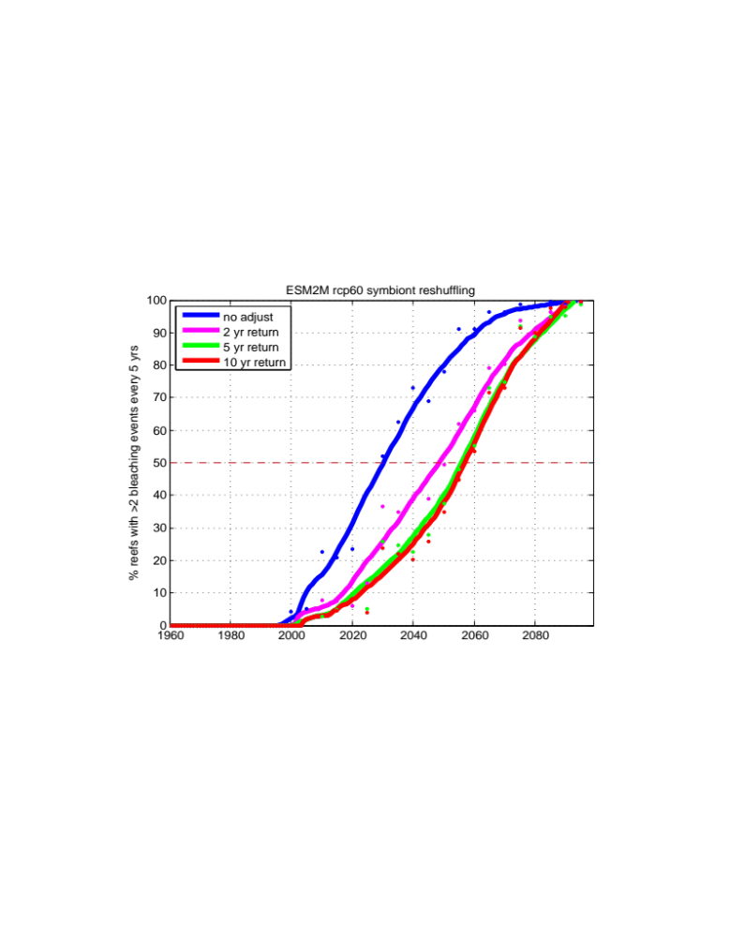
II. Thermal tolerance transiently increases after bleaching
% Global Reefs Bleaching >2x every 5yrs
6.5 W/m²
%
Year
Notes:
Delays onset but does not change

Slide 18
Conclusions
  Without acclimatization or adaptation, only the “aggressive mitigation” RCP scenario predicts < 100% of reefs undergoing high frequency bleaching by 2100
  If corals can “adapt” to their recent thermal history over the previous 40-60 years, severe bleaching could be prevented in over half of global reefs by 2100
  A transient increase in thermal tolerance after a bleaching event only moderately delays severe bleaching by 2100
≈ç
≈ç
≈ç
≈ç
≈ç
Notes:
SO hopefully I have shown you that the potential mechanisms would have a large effects on bleaching frequency predictions
What we need to know next is to what extent are these mechaisms acting and what if any are the upper maximum threshold limits

Slide 19
Conclusions
  Without acclimatization or adaptation, only the “aggressive mitigation” RCP scenario predicts < 100% of reefs undergoing high frequency bleaching by 2100
  If corals can “adapt” to their recent thermal history over the previous 40-60 years, severe bleaching could be prevented in over half of global reefs by 2100
  A transient increase in thermal tolerance after a bleaching event only moderately delays severe bleaching by 2100
≈ç
≈ç
≈ç
≈ç
≈ç
Notes:
SO hopefully I have shown you that the potential mechanisms would have a large effects on bleaching frequency predictions
What we need to know next is to what extent are these mechaisms acting and what if any are the upper maximum threshold limits

Slide 20
Conclusions
  Without acclimatization or adaptation, only the “aggressive mitigation” RCP scenario predicts < 100% of reefs undergoing high frequency bleaching by 2100
  If corals can “adapt” to their recent thermal history over the previous 40-60 years, severe bleaching could be prevented in over half of global reefs by 2100
  A transient increase in thermal tolerance after a bleaching event only moderately delays severe bleaching by 20-30 years
≈ç
≈ç
≈ç
≈ç
≈ç
Notes:
So it is clear that these potential adaptive mechanisms would have a large effects on bleaching frequency predictions
These results provide us some hope with an otherwise dire set of predictions
What we need to know next is to what extent are these mechanisms acting and what if any are the upper maximum threshold limits

Slide 21




Acknowledgements
GFDL Climate Ecosystem Modeling Group
Kenneth Casey (NOAA NODC)
Tess Brandon (NOAA NODC)
Jianke Li (NOAA Coral Reef Watch)
Gang Liu (NOAA Coral Reef Watch)
Joanie Kleypas (NCAR)
Lida Teneva (Stanford)
Salvador Jorgensen (Stanford)

